Slide 1
Conducting Internal Investigations
Stephen Kuperberg
GWU Healthcare Corporate Compliance Certificate Program, January 9, 2018

Slide 2
Agenda
Why conduct internal investigations
How to conduct internal investigations
What to obtain from internal investigations

Slide 3
Why conduct internal investigations?
Investigate potential misconduct—crucial compliance function
  Audit result
  Internal report
  Whistleblower

Slide 4

Why conduct internal investigations?
No government inquiry—yet
  OIG subpoena
  Civil investigative demand
  US Attorney office subpoena
  Congressional inquiry
  Dawn raid

Slide 5
Why conduct internal investigations?
Get to the bottom of allegations
Get ahead of external inquiries and related consequences
Identify issues and weaknesses
Stop any violations
Implement remedial actions
Prepare for any potential self-disclosure

Slide 6

Why conduct internal investigations?
You want to be a good corporate citizen
The government wants you to be a good corporate citizen
If a good corporate citizen discovered clear evidence of wrongdoing, what would it do?

Slide 7

Why conduct internal investigations?
If you find clear evidence of wrongdoing at any time—
STOP THE WRONGDOING IMMEDIATELY

Slide 8
Why conduct internal investigations?
Why not conduct internal investigations?
Internal investigations are retrospective and resource-intensive
Business frequently involves cost-benefit analysis with limited resources

Slide 9
Why conduct internal investigations?
Why not conduct internal investigations? Possibilities—
  Issue is prospective, not retrospective
  Issue is conclusively isolated, defined, and over
  Issue is subject of specific prior guidance of counsel
  Issue is subject of a previously obtained OIG opinion letter specific to your organization
Check. Your. Assumptions.

Slide 10

How to conduct internal investigations?
Before starting internal investigations, should you check with legal counsel?
Given the previous discussion, why not?

Slide 11
How to conduct internal investigations?
Checking with legal counsel doesn’t necessarily mean involving legal counsel
Certain benefits of legal counsel involvement—particularly attorney-client privilege and work product protections—do not apply retroactively
Effective counsel can often provide guidance to reduce cost and effort

Slide 12
How to conduct internal investigations?
When should legal counsel be involved? Allegations of—
  Violations of law
  Intentional fraud or misrepresentation
  Audit results demonstrating a pattern reaching beyond isolated errors
  Activity or audit results that highlight ambiguous or contradictory guidance or rules
Particularly important when government funds involved, but not only then

Slide 13
How to conduct internal investigations?
Why should legal counsel be involved?
Attorney-client privilege
Typically no privilege for routine compliance investigations and materials

Slide 14
How to conduct internal investigations?
Why should legal counsel be involved?
Attorney-client privilege
Protects
  Confidential
  Communications
  Between attorney and client
  For purposes of obtaining legal advice
Can apply to current and former employees
Can apply to attorney’s experts

Slide 15
How to conduct internal investigations?
Why should legal counsel be involved?
Attorney-client privilege
Common errors in establishing and preserving privilege
  Attorney not involved from outset
  Not confidential
  Not communications (doesn’t protect underlying facts)
  Not between attorney and client
  Not for purposes of obtaining legal advice
Confidentiality is most frequent issue

Slide 16
How to conduct internal investigations?
Why should legal counsel be involved?
Attorney-client privilege
Just as important as establishing the privilege is choosing whether and when to waive it, and to whom
If you never established an attorney-client privilege, or didn’t maintain it, you don’t get to choose later

Slide 17
How to conduct internal investigations?
Four steps to internal investigations
  Plan
  Investigate
  Assess
  Correct and report
Remember—
  Don’t wait to stop
  clear wrongdoing!

Slide 18
How to conduct internal investigations?
Plan
  What potential wrongdoing are we investigating?
  What potential violations are implicated?
    Anti-kickback violations
    Fraudulent billing
    Privacy violations
    Marketing or promotional violations
    Self-referrals
    Anti-competitive actions or agreements
    Other federal or state law

Slide 19
How to conduct internal investigations?
Plan
  Who knows about the issue?
    Who was involved?
    Who have we told?
Remember that management can’t act if they don’t know about the issue
The same is true of counsel

Slide 20
How to conduct internal investigations?
Who should direct the investigation?
  Counsel
  Compliance team
  Potentially including
    HR
    Auditors
    Management

Slide 21
How to conduct internal investigations?
Who should conduct the investigation?
  Counsel
  Compliance team
  Professional investigator
  Auditors
  IT

Slide 22
How to conduct internal investigations?
What will be the reporting protocol?
Consider both progress reporting and final reporting
  Internal investigation team
  Corporate management or board representatives

Slide 23
How to conduct internal investigations?
Preserving documents—establishing a document hold early is crucial
Put the hold in writing
Notify both employees and IT
Suspend document “retention” policies
  Applies to IT as well as physical retention
  Hold backup tapes
  Potentially image crucial folders and drives

Slide 24

How to conduct internal investigations?
Plan—document collection and interviews
Consider both time sensitivity and thoroughness
  Typically collect and review documents first if possible
  For complex financial and technical subjects, important to involve experts
But—the clock is ticking!

Slide 25
How to conduct internal investigations?
Investigate—knowledge center
  Collect documents and other materials (such as interview memoranda) centrally
  Be organized in your review
    Litigation databases helpful
  Create a centralized timeline-chronology

Slide 26
How to conduct internal investigations?
Investigate—interviews
  Your plan identified witnesses—and you should be on the lookout for more
  Interview individually
  Counsel should be providing the “corporate Miranda” or Upjohn warnings
  Use documents to guide and probe
  Gather information
  Assess credibility—but don’t interrogate
  Be open, curious, information-seeking
  Take detailed notes, but not verbatim or recordings

Slide 27
How to conduct internal investigations?
Investigate—interviews
  When to interview a suspected wrongdoer
    Beginning, end, or both
    Give opportunity to respond to all accusations
    Be open, curious, information-seeking
  The flip side of the Upjohn warnings—right to counsel

Slide 28
How to conduct internal investigations?
Assess
  Oral or written report, and to whom
    Remember—you planned for this
  Comprehensive summary
    Detailed description
    Appropriately sourced
    If making assessments or drawing conclusions, identify those assessments and their bases
      Provide opportunity for others to reach independent assessments—if making assessments at all
  Recommend corrective action

Slide 29
How to conduct internal investigations?
Correct and report
  In this case, deciding whether and how to report externally
Discipline referrals and recommendations
Follow-up and accountability on corrective actions

Slide 30
How to conduct internal investigations?
Correct and report—self-disclosure?
  Overpayment repayment obligations
  OIG self-reporting v. False Claims Act liability
  Other government disclosure programs—Antitrust Leniency-amnesty program

Slide 31
How to conduct internal investigations?
Correct and report—self-disclosure?
  Overpayment repayment obligations
  OIG self-reporting v. False Claims Act liability
  Other government disclosure programs—Antitrust Leniency-amnesty program

Slide 32

What to obtain
What to obtain from internal investigations?
A report, but also—
  Corporate integrity
  Good standing with government and community
  Preservation of resources
  Efficient and effective services
The clock is ticking—
But you got this

Slide 33
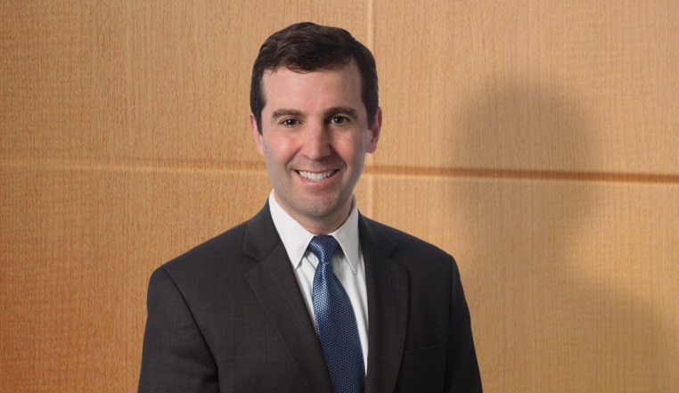
Questions?
Steve Kuperberg
Powers law firm
Steve.Kuperberg@PowersLaw.com
http://www.powerslaw.com

