Slide 1
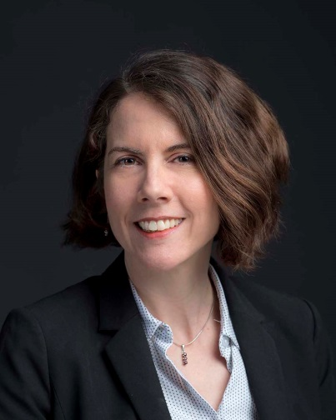
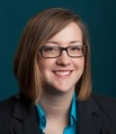
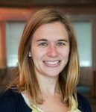
Contact Us
Christine Eibner
Senior Economist
Christine_Eibner@rand.org
703-413-1100 x5913
Jayme Fuglesten
Director, OCR
Jayme_Fuglesten@rand.org
703-413-1100 x5363
Kerry Allen
Health Legislative Analyst
Kerry_Allen@rand.org
703-443-1100 x5774
Notes:
For questions or to connect with RAND research or experts, you can contact Kerry Allen or Jayme Fuglesten in our Office of Congressional Relations

