Slide 1
The Move to value:
Provider and Patient Perspective on Opportunities and Pitfalls
Margaret C. Tracci, MD, JD
University of Virginia Health Care Symposium
325 Russell Senate Office Building
November 18, 2016

Slide 2
Goal
Reflection on the goals of health policy and how we evaluate success
Overview of MACRA and the move to value-based payment
Drill down on one aspect of MACRA- the bundled payment model
Evaluate the impact of episode-based bundled payment from the perspective of payer, provider, and patient
Illustrate the need to balance “big data” available to payers with “small data” generated by providers and patients

Slide 3
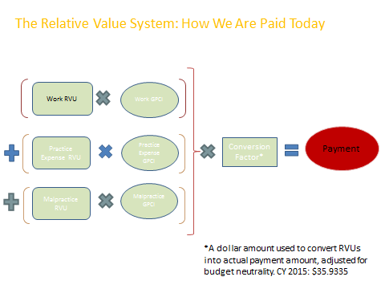
The Old System…
→ CY 2016: $35.8043
Notes:
Q1: What happened?
A: We work hard and like to be paid. Insurance seemed like a great solution, so we leapt at the opportunity. Looking back, as money gets tight, we are lying in the bed we’ve made over the past 250 years.
Q2: What do we do now?
A: Understand the problem. Help make sure that the solution works. Work with policymakers to make sure that the solution works.

Slide 4
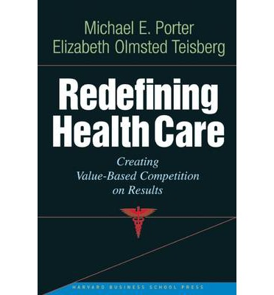
The New System…
VALUE = OUTCOME
COST

Slide 5
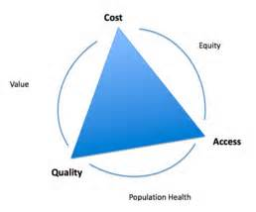
The Iron Triangle
Notes:
The Iron Triangle of Health Care
“Breaking the Iron Triangle: Reducing Health-Care Costs in Corporate America” Outlines A Sustainable Health-Care Model That Can Eliminate 70% of Unnecessary Medical Visits
About the Author:
An acupuncturist, healer, and educator for more than 40 years, Robert “Bob” M. Duggan is a pioneering leader in the emergence of complementary medicine and a groundbreaking voice for wellness in the United States. Duggan is the co-founder, president emeritus, and a faculty member of the Tai Sophia Institute, the first accredited acupuncture school in America, and now a leading graduate school for integrative health and wellness. He has served as an advisor to policymakers and organizations, including testifying before the Senate Committee on Health, Education, Labor, and Pensions, and as a speaker at the National Institutes of Health (NIH), the White House Commission on Complementary and Alternative Medicine, and TEDx events. Duggan’s first book was Common Sense for the Healing Arts.

Slide 6
April 16, 2015: Passage of the Medicare Access and CHIP Reauthorization Act (MACRA)
Repealed the Sustainable Growth Rate Formula (SGR)
Transition away from fee-for-service reimbursement

Slide 7


Medicare Access and Children’s Health Insurance Program Reauthorization Act (MACRA)
Physician Payment 2019-2024
PQRS
EHR
VBU
Current Programs
Merit-Based Incentive Payment System (MIPS)
Composite MIPS Score*
Quality
Resource Use
EHR/MU
Clinical Practice Improvement Activities
*Each MIPS category scored 0-100
Alternative Payment Mechanisms (APM)
ACO
Bundled Payments
PCMH
New Programs

Slide 8
What Does Value Mean To…
The Payer?
The Provider?
The Patient?

Slide 9
The Payer
Use incentives/penalties to hold provider X accountable for costs in population Y, while applying quality metrics Z
  X: individual MD, single specialty group, multispecialty group, ACO, state…
  Y: individual patient, prospective group, retrospective group
  Z: process, outcomes, patient-centered, patient-reported
Examples:
  Hospital: Value-Based Purchasing
  Physicians: Value-Based Modifier→ MACRA
  Integrated groups: Accountable Care Organizations
Notes:
Hospital: Value-Based Purchasing
Physicians: Value-Based Modifier→ MACRA
Integrated groups: Accountable Care Organizations

Slide 10

The Provider

Slide 11
Physician Anxiety About MACRA: Cost
Payers may see cost savings, but: financial impact of value models on providers difficult to predict
Substantial costs to adapt/adopt
Significant new compliance cost, including IT and annual reporting changes
Distribution of cost exposure/shared savings among providers unclear
Significant, unpredictable effects of consolidation

Slide 12
Physician Anxiety About MACRA: Quality
Metrics
  Little actionable data with regard to improving outcomes
  Current value models primary care focused, many providers have access to few clinically relevant measures
  Continued dependence on process measures
  Unclear how to incorporate patient-centered metrics

Slide 13
Physician Anxiety About MACRA: Access
Focus on cost reduction blunt
  Short term view of cost reduction
  Reduction in referrals
  “Appropriateness” more difficult to achieve
Workforce
  Regulatory burden/workflow impact on productivity
  Aging workforce/early retirement trend
  Impact of employed physician model on productivity

Slide 14
The Patient?
Will come back to this later…

Slide 15
Back to The Iron Triangle
Notes:
The Iron Triangle of Health Care
“Breaking the Iron Triangle: Reducing Health-Care Costs in Corporate America” Outlines A Sustainable Health-Care Model That Can Eliminate 70% of Unnecessary Medical Visits
About the Author:
An acupuncturist, healer, and educator for more than 40 years, Robert “Bob” M. Duggan is a pioneering leader in the emergence of complementary medicine and a groundbreaking voice for wellness in the United States. Duggan is the co-founder, president emeritus, and a faculty member of the Tai Sophia Institute, the first accredited acupuncture school in America, and now a leading graduate school for integrative health and wellness. He has served as an advisor to policymakers and organizations, including testifying before the Senate Committee on Health, Education, Labor, and Pensions, and as a speaker at the National Institutes of Health (NIH), the White House Commission on Complementary and Alternative Medicine, and TEDx events. Duggan’s first book was Common Sense for the Healing Arts.

Slide 16
Drilling Down on MACRA
Alternative Payment Model: Bundled Payment
  Overview
  Evaluation
    Payor, provider, patient viewpoints
    The Iron Triangle: impact on cost, quality, access

Slide 17


Alternative Payment Mechanisms (APM)
ACO
Bundled Payments
PCMH
New Programs
2019-2024: 5% Bonus for Participation
25% of revenue: 2019-20
50% of revenue: 2021-2022
75% of revenue: 2023
AND
Providers who qualify for APM bonus exempt from MIPS requirements
2025 and beyond: conversion factor
FFS 0.25%/year
APM 0.75%/year
Notes:
5% bonus: 2019-2024
Receive a significant percentage of revenue from an APM
25%: 2019-2020, 50%: 2021-2022, 75%: beginning in 2023

Slide 18
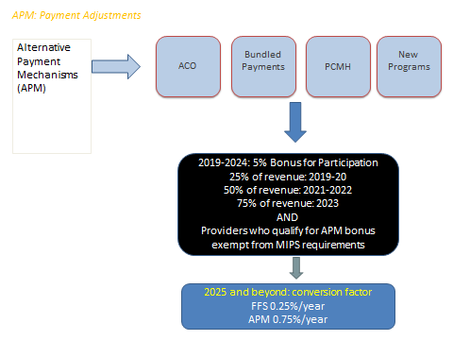
Drilling Down on MACRA

Slide 19
Bundled Payment
Outpatient Professional
Professional services
Inpatient Professional
Index Hospitalization
SNF
Readmission
Inpatient Stays
30 - 180 day look-forward
Brandeis University
Notes:
19
Trigger
Time window
Rules to assign claims to the bundle
Risk adjustment
19

Slide 20
Impact?
Payer: Saves money, shifts risk to provider
Provider: Little experience managing risk, but potential shared savings, challenging implementation
Patient: ?
Notes:
Implementation: clinical content/parameters/rules of episodes, attribution rules, quality metrics, financial risk arrangements

Slide 21
Social Determinants of Health
WHO definition: The circumstances in which people are born, grow up, live, work and age, and the systems put in place to deal with illness. These circumstances are
in turn shaped by a wider set of forces: economics, social policies, and
politics.²
Potential social determinants of health?
  Geography: region, state, urban/rural, neighborhood
  Race, ethnicity, culture
  SES
  Household characteristics: family structure, marital/parental status
Risk adjustment:
  Quality metrics, expected cost are often adjusted to account for clinical factors (age, disease severity, etc) that impact expected outcomes
  Do not adjust for SES and other nonclinical determinants of health
  Ongoing NQF focus, CMS report to Congress due this month
  Major advocacy focus of safety net hospitals

Slide 22
SDH and Value-Based Payment
About SES/Social Determinants of Health
  SES affects patient-reported outcomes
    Disability, welfare associated with lower patient rating of care
  Low SES associated with hospital outcomes
    Hospital characteristics? Patient characteristics?
  Low SES patients more likely to require posthospital care
    Associated with limited resources and support, including transportation and family support in the home
About Bundles
  CJR reduce costs/episode but increase # episodes/overall cost
  CJR cost savings from posthospital care
  SES impact hospital/provider decision to offer tx/patient access to tx

Slide 23
The Patient’s Perspective: Hard Questions
Patient experience/outcomes:
  Will the quality of my care be judged based on measures that are meaningful to me?
  Will my providers be reluctant to offer services that may benefit me in the long term but are more expensive and do not improve short term quality metrics?
Patient access:
  “Cost profiling”: If I am a minority or of low SES am I less likely to be offered certain services?

Slide 24
Opportunity
We have an unprecedented opportunity to critically evaluate rapidly evolving policy
  Ask CRITICAL questions at the provider/patient interface
    Integrated approach to both patient care and policy assessment
    Payers, providers, patients
    Economists, health informaticists, health services researchers, clinical researchers, social scientists…
  Balance “Big Data” on cost/outcomes with “Small Data”
  Develop an iterative approach to policy development

Slide 25
Program Evaluation: Lessons
“Big data”
  Cost easier to pinpoint than quality
  Appropriateness elusive
    Focus on volume/cost may inappropriately reduce access
“Small data”
  Critical to involve front line caregivers
  Critical to incorporate patient-reported functional and QOL outcomes
  Continue to define appropriateness, cost/benefit at the patient level
  Be attentive for unintended consequences (cost profiling)

Slide 26
The Iron Triangle
Notes:
The Iron Triangle of Health Care
“Breaking the Iron Triangle: Reducing Health-Care Costs in Corporate America” Outlines A Sustainable Health-Care Model That Can Eliminate 70% of Unnecessary Medical Visits
About the Author:
An acupuncturist, healer, and educator for more than 40 years, Robert “Bob” M. Duggan is a pioneering leader in the emergence of complementary medicine and a groundbreaking voice for wellness in the United States. Duggan is the co-founder, president emeritus, and a faculty member of the Tai Sophia Institute, the first accredited acupuncture school in America, and now a leading graduate school for integrative health and wellness. He has served as an advisor to policymakers and organizations, including testifying before the Senate Committee on Health, Education, Labor, and Pensions, and as a speaker at the National Institutes of Health (NIH), the White House Commission on Complementary and Alternative Medicine, and TEDx events. Duggan’s first book was Common Sense for the Healing Arts.

Slide 27
References
Macht R, McAneny D, Doherty G. Challenges in surgical quality at safety net hospitals. JAMA Surgery 2016;151(9):795-96
Waljee J, McGlinn EP, Sears ED, Chung K. Patient expectations and patient-reported outcomes in surgery: a systematic review. Surgery 2014;155:799-808
Dummit LA, Kahvecioglu D, Marrufo G, Rakumar R et al. Association between hospital participation in a Medicare bundled payment initiative and payments and quality outcomes for lower extremity joint replacement episodes. JAMA 2016.316(12):1267-1278
Ibrahimi SA, Kim H, McConnell KJ. The CMS Comprehensive Care Model and racial disparity in joint replacement. JAMA 2016;316(12): 1258-1259
Fisher E. Medicare’s bundled payment program for joint replacement. Promise and peril. JAMA 2016;316(12):1262-1263
Episode Grouper for Medicare (EGM) Design Report. Brandeis University. February 29, 2016

Slide 28
Questions?

