Slide 1
The Health Insurance Marketplace:
Expanded Access, Smarter Spending, Better Care and Healthier People
Kevin Counihan
Centers for Medicare & Medicaid Services
November 2016

Slide 2
Roadmap
ACA by the Numbers
Game Changers
Marketplace Stability
Innovation
Upcoming Open Enrollment and Continuous Improvement
Looking Forward

Slide 3
ACA By the Numbers
129 million adults can no longer be denied coverage for a pre-existing condition
105 million Americans no longer have a lifetime limit on their health coverage
137 million Americans are benefiting from preventive care coverage
2.3 million young adults gained health insurance coverage due to the ACA provision allowing young adults to remain on a parent’s plan until age 26

Slide 4
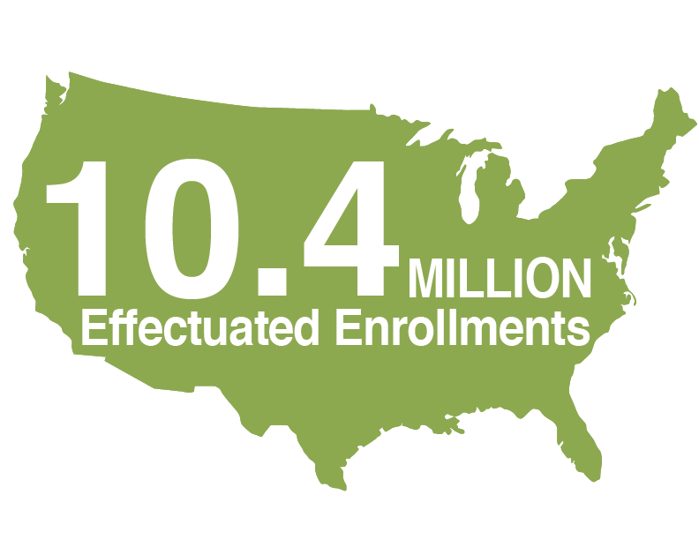
Health Insurance Marketplace
85% of consumers qualify for financial assistance
Notes:
Progress–
Just six years ago, millions of Americans were locked out of our health care system because they couldn’t afford insurance or because they had pre-existing conditions. Women were charged more than men simply because they were women. At the same time, rising health care costs posed a significant threat to our economy, and while costs were high, the quality of care often wasn’t.

Slide 5
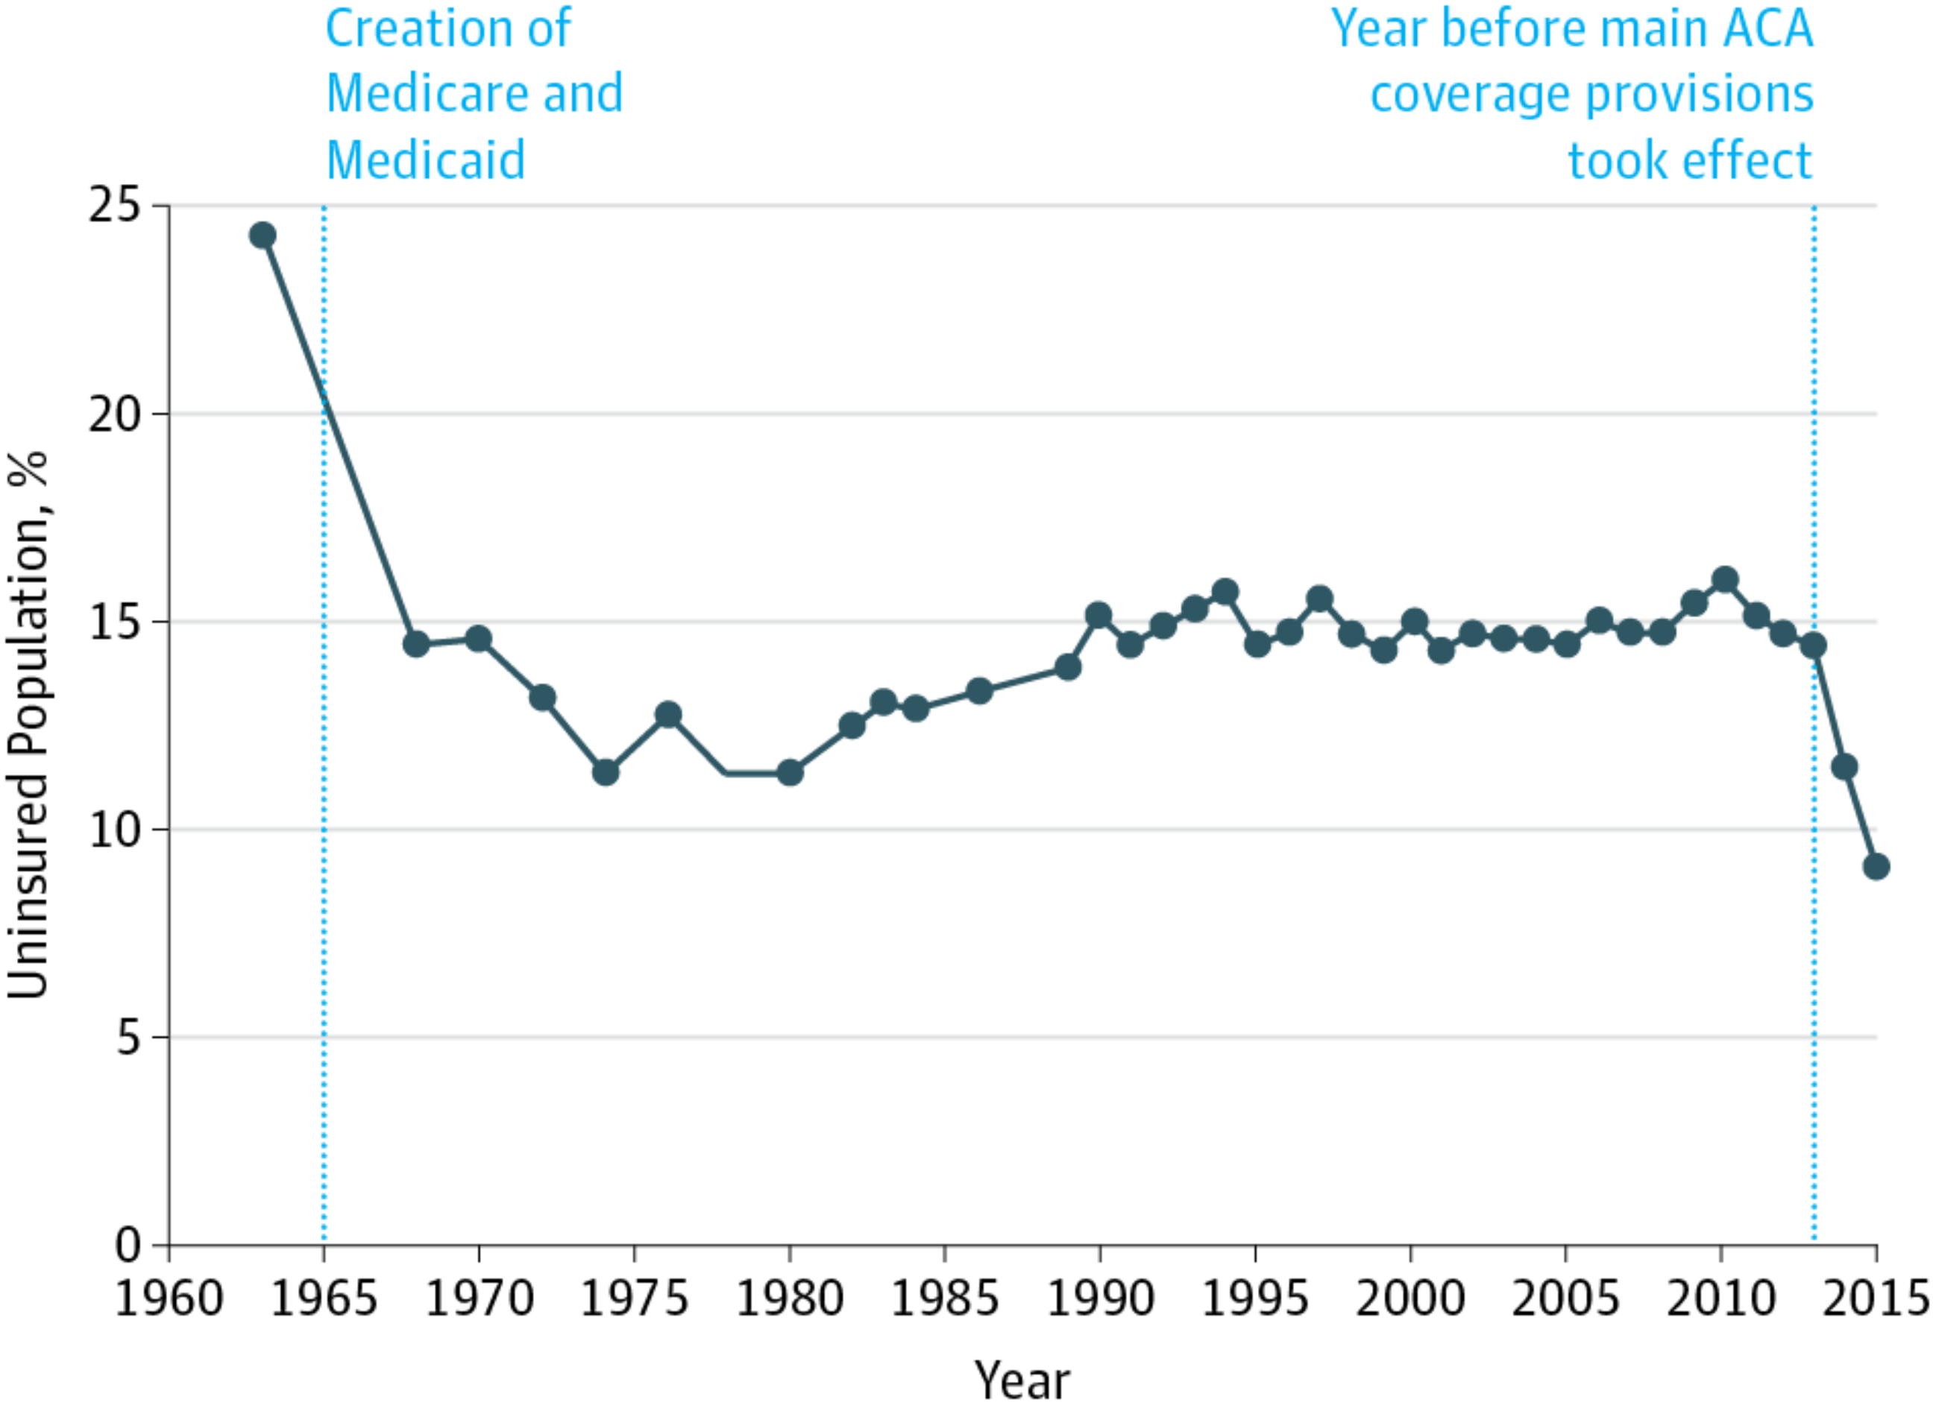
The Affordable Care Act Has Driven the Uninsured Rate Below 10 Percent For the First Time Ever
ACA has generated the most rapid coverage gains since Medicare and Medicaid
The uninsured rate is now at 8.7%, below 10% for the first time ever this year
United States Health Care Reform: Progress to Date and Next Steps
  JAMA. Published online July 11, 2016. doi:10.1001/jama.2016.9797
Notes:
Today, 20 million Americans now have coverage because of the ACA. The U.S. uninsured rate has dipped below 9 percent for the first time ever. The uninsured rate is now down to 8.7 percent, from 14.4 percent in 2013, according to data from the CDC.
The uninsured rate is at its lowest level in our nation’s history.

Slide 6
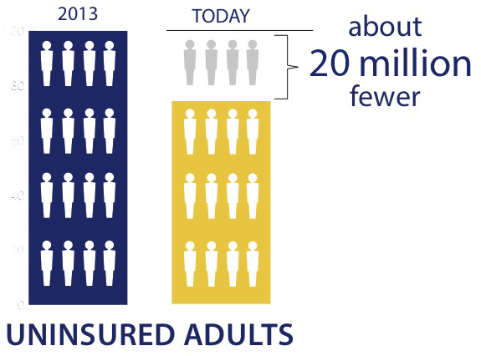
ACA by the Numbers
The uninsured rate fell to 8.7 percent in 2016
Fewer than 1 in 10 Americans lacked health insurance.

Slide 7
Marketplace Satisfaction
Notes:
Marketplace consumers are satisfied and getting access to care.
Satisfaction: Multiple surveys have placed consumers’ satisfaction with their Marketplace plans on par or better than employer coverage.
Access to care: According to an Urban Institute study, large majorities of Marketplace consumers had a usual source of care and are getting routine check-ups – about the same fractions as among people with employer coverage.
* http://www.jdpower.com/press-releases/2016-member-health-plan-study

Slide 8
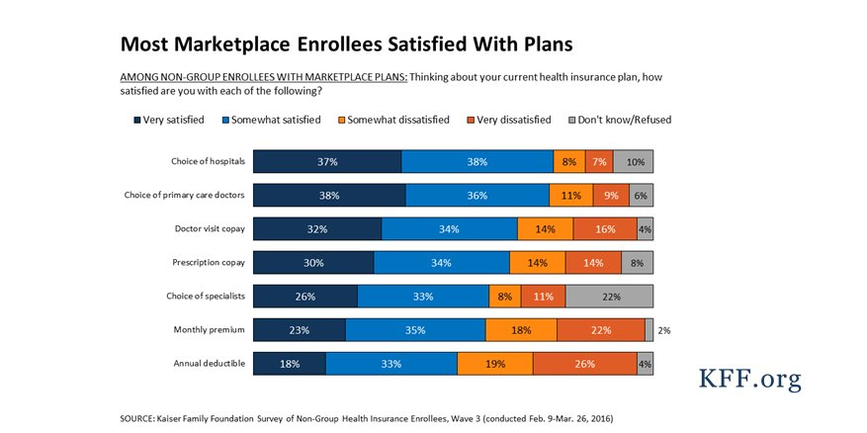
Marketplace Satisfaction
75% were satisfied with their choice of hospitals
74% were satisfied with their choice of primary care doctors
Notes:
This Kaiser Family Foundation survey found similar evidence—a couple of highlights:
75% were satisfied with their choice of hospitals
74% were satisfied with their choice of primary care doctors

Slide 9
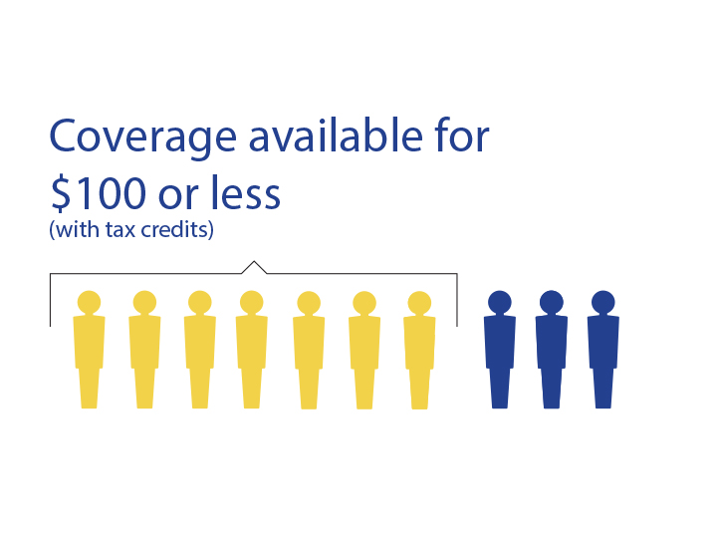
Affordability
Notes:
Less than $75 for HealthCare.gov: Most Marketplace consumers will be able to select a plan for less than $75 per month next year.
Last year the average cost of HealthCare.gov coverage for people getting tax credits went from $102 to $106 per month, a $4 change, despite suggestions of “double-digit price hikes.”
Even if premiums were to increase 25%, 73 percent of Marketplace consumers would be able to find a 2017 plan for $75 per month.
Shopping gives all consumers a chance to find the best deal, whereas reported rate changes assume people stay in the plan they have. Last year, people who switched plans saved an average of $42 per month, or about $500 annually.
Recent data from CMS shows that the median individual deductible for HealthCare.gov Marketplace policies (after taking into account cost-sharing reductions) in 2016 is $850, down from $900 in 2015.**
*Denotes data from the ASPE March 2016 Report: https://aspe.hhs.gov/sites/default/files/pdf/187866/Finalenrollment2016.pdf
All other figures are from OEDA analysis of CMS data.
^APTC and net premium calculations are from the ASPE reports, which are calculated at the policy level with a cap on EHB.
**CMS data released July 2016 https://www.cms.gov/Newsroom/MediaReleaseDatabase/Fact-sheets/2016-Fact-sheets-items/2016-07-12.html

Slide 10
Game Changers
Financial Assistance
  85% of consumers are taking advantage of tax subsidies
Quality Health Insurance: Essential Health Benefits
  Ending of “transitional” policies; limiting short duration policies
Guaranteed Issue
  Coverage for chronic illness
Transparent shopping platform: HealthCare.gov
  Side by side price comparison, new look-up tool for doctors, hospitals and drugs, quality star ratings

Slide 11
Early Lessons Learned
Affordability reigns supreme
  70% of returning consumers came back and shopped
  Consumers are shopping for health care, not just health coverage
  Doctor, hospital, drug and quality all important
No change in employer based coverage
  CBO projections were incorrect
Maturation of the Marketplace
  Risk Adjustment, Special Enrollment Periods, Data Matching
Innovation, Innovation, Innovation!
      Innovative approaches to network strategy, care management models, new product approaches, benefit designs, customer retention
      "One size fits all" approach to Marketplace enrollees less successful

Slide 12
Marketplace Stability
The Marketplace provides health care by centering on quality, cost-effectiveness, and consumer engagement
We are taking steps to strengthen the risk pool
  Risk Adjustment
  Special Enrollment Periods
  Data Matching
  Transition to Medicare
Increasing Marketplace outreach and partnerships
Notes:
The long-term stability of the Marketplace is our goal. In its third year of operation, the Health Insurance Marketplace is a dynamic platform offering many choices for consumers. We are eager to work actively our stakeholders, like issuers, health insurance companies, and folks like YOU, as the Marketplace moves from start-up to stability.
Everyone agreed that companies would need to plan and adjust as they transition to this new market. We’ve frankly seen some health insurance companies work hard to succeed in this new market.
Special enrollment periods (SEPs) exist to ensure that people who lose coverage or experience other qualifying events have the opportunity to enroll in coverage. We are committed to making sure that SEPs are available to those who are eligible for them and equally committed to avoiding any misuse or abuse of special enrollment periods. In 2016, we took a number of steps to ensure appropriate use of SEPs, such as introducing a confirmation process under which consumers enrolling through common SEPs are directed to provide documentation to confirm their eligibility. In the proposed rule, we are seeking information on additional steps related to SEP outreach or policy we could take as soon as the 2017 plan year to strengthen the SEP risk pool.
We’re helping ensure consumers who turn 65 are moving into Medicare and off the Marketplace, and already this year we’ve begun to see the impact of the efforts we’ve made to do that, as we saw a precipitous drop in dual enrollment with those who just turned 65 in August.

Slide 13
Marketplace Innovation
The Marketplace serves as a laboratory for provider, payment, and care innovation
  Locally focused based on population health and other factors
  Data-driven strategies
  Paying for quality of care, not quantity of services
  Better care coordination
    “Place of Delivery (POD)” models to locally connect providers and care coordination teams where members live
Notes:
But, we’ve also seen others succeed in providing affordable care for the newly insured all across the country in a diverse set of markets, while gaining early positive balance sheets for their Marketplace business. Many have recently expressed both confidence in the future of the Marketplace and enthusiasm for growing their Marketplace business.
We are pleased with the progress that we have made together, but we are always looking for ways to improve. To make sure the market stays strong, we have taken a series of steps over the last few months. From your work on new guardrails around SEPs, to early reinsurance earlier information on risk adjustment, as well as changes to the risk adjustment formula and new guidance to clarify ways we can work with issuers to reach out to young adults as they age off their parents’ plans, we are eager to work together to implement this work.

Slide 14
Proposed Risk Pool Improvements
Proposed improvements to risk adjustment
  Partial year enrollees
  Pharmacy data
  Risk sharing for enrollees over $2m
  Healthier enrollees
Notes:
The ACA’s risk adjustment program plays an important role in ensuring that issuers have both the incentives and the financial support to design products to serve all Americans, and today’s rule proposes significant actions to strengthen the risk adjustment program. These changes will support issuers in serving the highest cost enrollees while also seeking to make risk adjustment more predictable and more effective at spreading risk for all issuers.
Specifically:
Beginning with the 2017 benefit year, the rule proposes a modification to risk adjustment regarding the cost of enrollees who do not stay with an issuer for the full plan year.
In order to help reflect enrollees with serious conditions like Hepatitis C, HIV, or others, the rule proposes to use prescription drug utilization data as a source of information about enrollee’s health and the severity of their conditions beginning with the 2018 benefit year.
The rule also proposes to modify risk adjustment as to costs associated with the most expensive enrollees. Under this proposal, a portion of costs exceeding $2 million for an individual would be shared among issuers. This type of risk sharing would reduce uncertainty for issuers who are not yet able to reliably predict the prevalence and nature of high-cost cases.
The proposed rule also asks for comment on a number of approaches for addressing the costs of healthier enrollees. Our goal is to update risk adjustment for all types of enrollees, to ensure that issuers can have confidence in the program as they design products to attract all types of consumers.
Lastly, separate from the risk adjustment program, we are seeking comment on whether and how to further support the successful transition of former Pre-Existing Condition Insurance Plan (PCIP) Program enrollees into the Marketplace to ensure that they do not experience a lapse in coverage.

Slide 15
Open Enrollment for 2017
Easy to Enroll – New improvements make enrolling on HealthCare.gov easier, more convenient, and more streamlined than ever.
Here When You Need It - With no more pre-existing condition carve outs, lifetime limits, or annual caps, health insurance finally IS there when they need it.
Notes:
Easy to Enroll – New improvements make enrolling on healthcare.gov easier, more convenient, and more streamlined than ever. Consumers sign-up anywhere-anytime ; from a smartphone, tablet, or computer and better functions give you side by side shopping, real time financial help, and doctor/drug lookup tools to help you pick the right plan for you and your family.
Here When You Need It - With no more pre-existing condition carve outs, lifetime limits, or annual caps, health insurance finally IS there when they need it. This year’s open enrollment gives all consumers – new or existing, young and single or married with families – the opportunity to easily find the coverage they can afford. And for the approximately 9M people who paid the penalty last year for going uninsured, don’t miss out again. Healthcare.gov is ready for you!

Slide 16
Continuous Improvement
Doctor, Hospital and Drug Look-up Tool
  3.6 million consumers have used this tool to more easily search for the plan
  that matches their needs
Star Ratings Pilot
  Will show Quality Star Ratings (QSR) to consumers in certain states using HealthCare.gov during the 2017 open enrollment period
  Pilot allows us to see how consumers access and use QHP quality rating information to inform future display of QSR
Simple Choice Plans
  Plans that have a uniform set of features like fixed deductibles and
  out-of-pocket limits
  Consumers can compare plans on fewer plan factors like monthly premium
  Will display as part of the shopping experience on HealthCare.gov

Slide 17
Looking Forward
The Marketplace is large and growing
Consumers are engaged: Shopping, Look-up Tool, Star Ratings
New learning and experimenting in the Marketplace
Notes:
HealthCare.gov is open for consumers to come and shop and find a wide variety of affordable choices.
Subsidies help make coverage affordable
Quality coverage in demand
Innovative approaches from issuers
As the Marketplace continues to grow and mature, one of our most important priorities is to study data, listen to a range of market participants, test out different approaches, and adapt to what we see and hear. We have a number of tools to make adjustments like the ones we are proposing today, and are confident in our ability to make the Marketplace an even more attractive market for consumers and health plans alike.

Slide 18
Thank You
Looking Forward
Questions?

