Slide 1

“If You Can’t Measure It, You Can’t Manage It”
The Misquote That Launched 1000 Ships – or at Least MACRA Legislation
Robert Berenson M.D.
Institute Fellow, Urban Institute
rberenson@urban.org
Health Care Symposium – “Health Reform: Where Are We; Where Are We Going?”
Russell Senate Office Building
18 November 2016
URBAN INSTITUTE

Slide 2
“If you can’t measure it, you can’t manage it”
And its close cousin, “If something… cannot be measured, it cannot be improved.”
Called a truism, the quote is commonly attributed to W. Edwards Deming, now deceased, a widely revered expert in management and management science
URBAN INSTITUTE

Slide 3
What Deming actually wrote and believed
“It is wrong to suppose that if you can’t measure it, you can’t manage it – a costly myth.”
  The New Economics, 1994, page 35.
  So not just taken out of context, but an overt, (intentional?) misquote
Other consistent Deming quotes (of many available):
  “The most important figures one needs for management are unknown or unknowable, but successful management must nevertheless take account of them.” Out of the Crisis, 1982, p 121
  “Management by numerical goal is an attempt to manage without knowledge of what to do, and in fact is usually management by fear.” Out of the Crisis, p. 76
URBAN INSTITUTE

Slide 4
Dueling slogans
“If you can’t measure it, you can’t manage it”
“Not everything that can be counted counts, and not everything that counts can be counted.”
  Commonly attributed to Albert Einstein, it was actually coined by a sociologist named William Bruce Cameron, writing after Einstein had died
URBAN INSTITUTE

Slide 5
No wonder we don’t do evidence-based policy making
We can’t even get quotes right
URBAN INSTITUTE

Slide 6
One must distinguish measures for public reporting and P4P and for internal QI
Of course, for QI, having performance data is often desirable or essential, e.g., hypertension
For QI, one can be less rigorously accurate – reputations are not at stake. Screen and verify
The different purposes – QI v P4P – generate very different data sets, with little overlap
My concern here is the public policy infatuation with P4P, not with how organizations use measures as part of QI to produce reliable processes (what Deming did care about)

Slide 7
P4P (MIPS) does increase value
It is conceptually flawed because it crowds out “intrinsic motivation” that professionals have
  Testing to the test, while overall performance declines?
Relevant and accurate measurement is difficult and very costly. Some problems, like many of the measure gaps, won’t be fixed any time soon (despite MACRA expectations).
The accumulating evidence on P4P across more than a dozen OECD countries finds no evidence that P4P in practice meets the “compelling logic” that P4P advocates assert
URBAN INSTITUTE

Slide 8
The public understandably does not rely much on ratings based on current measurement
Four prominent hospital rating programs (not Consumers Reports) identified different sets of high performing hospitals – with very few overlaps
  Each system uses its own rating methods, has a different focus to its ratings, and stresses different measures – Austin, et al. Health Affairs, Mar. 2015
  The ratings may have made good sense to the ratings’ producers, but what is the public supposed to make of it?
  In other economic sectors ratings are about performance that consumers understand and care about, relying on regulatory bodies to assure safety and address technical issues. This doesn’t apply to health care.
URBAN INSTITUTE

Slide 9
The current policy infatuation with public reporting and, especially, P4P has lead to this perverse policy result:
What we measure publically is considered important and demanding attention while
What we can’t or don’t measure is marginalized or ignored altogether -- like diagnosis errors, a major, largely ignored, quality problem or workforce needs for an aging population
URBAN INSTITUTE

Slide 10
How to improve the use of measurement in public policy (from Berenson, Pronovost, and Krumholz )
Use measures strategically as part of major quality improvement initiatives, not as ends in themselves;
Measure at the level of the health care system and then the organization, not the clinician (“information brokers” do that);
Expedite moving from processes to outcomes (but not easy);
Place greater emphasis on patient experience and patient-reported outcome measures as important in themselves;
Invest more in the “basic science” of measurement development, tasking a single entity with defining standards for measuring and reporting performance:
  to improve the validity and comparability of publicly-reported quality data and
  to anticipate and prevent unintended adverse consequences
URBAN INSTITUTE

Slide 11
The Medicare Access and CHIP Reauthorization Act of 2015
(MACRA)
URBAN INSTITUTE

Slide 12
“Stabilizes” fee updates
Repeals SGR, averting a nearly 25% cut in fees
July 2015-2019: Annual fee update 0.5%, 2020-2025 0%
  Payment increases (and decreases) take place through MIPS
After 2025: 0.25% update, but 0.75% if APM participation
Before 2025, 5 percent bonuses for six years for physicians that qualify as participating in APMs with more than “nominal risk”
  Qualified medical homes count as APMs without risk
  Participants in APMs get out of the MIPS
URBAN INSTITUTE

Slide 13
The MACRA Quid Pro Quo for repeal of the Sustainable Growth Rate
The actual substantial cost of the not reducing physician fees by >20% was paid for through a long-term schedule of nominal fee increases
The quid pro quo – the concept of moving from payment “volume to value” -- was not primarily about paying for the SGR fix, but rather about aspirationally desirable improvements in delivery
There are two arms of the strategy – the Merit-based Incentive Payment System and Alternative Payment Models – clinicians (or their organizations) are given a choice
URBAN INSTITUTE

Slide 14
The Merit-based Incentive Payment System (MIPS)
Combines the 3 current incentive programs:
  Physician Quality Reporting System (PQRS) – quality
  Value-Based Modifier (VBM) – quality & resource use
  Meaningful Use (EHR)
Applies to payments after January 1, 2019 – the current programs are in use till then and sun-setted
Applies to all the types of health professionals receiving fee schedule $’s
Excludes those with too few Medicare patients or Medicare revenues and those who have threshold level of payment through alternative payment methods
May participate through EHR use, qualified clinical data registries and/or through group, “virtual” group or affiliation with a facility or hospital
URBAN INSTITUTE

Slide 15
MIPS assessment categories
(percentages when fully phased in in 2022)
Quality (30%)
Resource Use (30%)
Meaningful Use of EHRs (25%)
Clinical Practice Improvement Activities (15%)
  Such as expanding practice areas, population management, care coordination, beneficiary engagement, patient safety
URBAN INSTITUTE

Slide 16
MIPS payment adjustments
Negative adjustments capped
  Those at 0-25% of threshold get maximum negative adjustment
    2019: 4%
    2020: 5%
    2021: 7%
    2022: 9%
Positive
  Maximum: 3 X annual cap for negative adjustment – so theoretically as much as 27% more (I am not kidding)
  Eligible for additional payment if 25% above performance threshold
    But total is capped at $500 million / year (2019-2024)
The negative adjustments fund the bonuses + the $500m
URBAN INSTITUTE

Slide 17
The food here is terrible -- and such small portions
-- 1920’s Catskill’s joke
URBAN INSTITUTE

Slide 18
What MACRA got right
Repealing and paying (sort of) for the SGR repeal
Combining three separate P4P programs into one (but functionally there now are four categories, each with measures to report, although fewer)
Reducing the immediate financial impact of the MIPS with a phase in to the 9% or more rewards and penalties
Including “clinical practice improvement” as a new component of accountability
Promoting alternative payment models as the fundamental objective in the move from volume to value
URBAN INSTITUTE

Slide 19
What MACRA got wrong
It is numbingly complex, rewarding providers able to do “game theory,” and threatens small practice survival
The timelines are overly ambitious and will lead to flawed APMs – per capita costs in Medicare are as flat as ever at
~ GDP growth. Where’s the fire?
The idea that CMS can and should place a rating on each physician’s value reflects Congressional overreach
How does rewarding physicians with an extra 5% off the top add up to program savings when we don’t have models that we know actually reduce spending?
The complex of public reporting, P4P, and APM demos diverts attention from other opportunities to improve value

Slide 20
CMS deserves credit for the Oct.14 final MACRA Rules for:
Exempting nearly 400,000 clinicians, most from small practices, with annual revenues of <$30,000
In year one, eliminating the resource cost component of the composite score
Reducing, focusing and renaming the measurement requirements related to EHR adoption – from Meaningful Use to Advancing Care Information
Providing a “transition year” for clinicians – effectively postponing the kick-off of data collection by 9 months, if so desired, and let clinicians experience the process
Buying time so policy makers both in Congress and the new Administration can reconsider what they have wrought
URBAN INSTITUTE

Slide 21
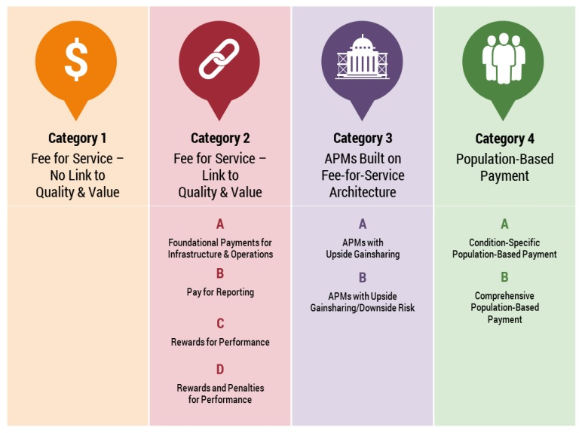
CMS/LAN APM Framework
URBAN INSTITUTE

Slide 22
Some Observations About the CMS/LAN Framework
Emphasizes theoretical incentives in payment methods, mostly ignoring the design and operational issues that working together influence clinician behavior
Assumes that value derives only from 1) use of quality measures and 2) financial risk-bearing
In short, the LAN Framework that classifies 28 payment is useful for presenting a continuum of payment method structural elements (measures and risk) but errs in implying that value follows the same continuum
Any payment method can be designed to produce more or less value – and that includes classic fee-for-service, in this case, the Medicare Physician Fee Schedule
URBAN INSTITUTE

Slide 23
Thanks
URBAN INSTITUTE

