Slide 1


Introduction and Objectives
Jim Pyles
Co-Founder, Principal: Powers Pyles Sutter & Verville, P.C.
November 18, 2016
10:00 a.m. to 2:00 p.m.
325 Russell Senate Office Building
HEALTH CARE SYMPOSIUM
“Health Reform: Where Are We; Where Are We Going?”
Sponsored by Powers Pyles Sutter & Verville PC
And
Frank Batten School at University of Virginia

Slide 2
Agenda
Introduction and Objective
  10:10-10:05 am – Jim Pyles
  10:05-10:10 am – Michael D. Williams, MD, FACS
Congressional Perspective, Senate Staff
  10:10-10:25 am – Marvin Figueroa, Kristin Malloy, Sarah Schmidt, MPH
Presentation
  10:25-11:00 am – Christine Eibner
  11:00-11:35 am – Bob Berenson
Presentation
  11:35 am-12:10 pm – Kevin Counihan
  12:10-12:15 pm – [Box lunches to be obtained during seat of next panel]
Panel #1
  12:15-12:30 pm – Michael D. Williams, MD, FACS
  12:30-12:45 pm – Margaret (Mimi) F. Riley, JD
Panel #2
  1:00-1:40 - Margaret C. Tracci, MD, JD; Brooke Lehmann; Mary Margaret Frank, BS, Macc, PhD; Christopher J. Ruhm, PhD
  1:40-2:00 pm - Questions

Slide 3
The Challenge
How can Congress make the best health care in the world more accessible and affordable without sacrificing quality AND in a way that the public will support?

Slide 4
Our Goals for Today
Provide a non-partisan summary of the facts of the ACA’s impact
Identify lessons learned
Suggest a non-partisan approach that will produce health policy the public will support
Provide a source of non-partisan accurate information and research

Slide 5
Lessons Learned
Legislation as sweeping as the ACA must be bipartisan
In order for legislation to last, it must have popular support
In order to have popular support, legislation must be consistent with public expectations

Slide 6
Suggestion: A Principled Approach to Health Reform Policy
Put the patients’ interests first – they are the only group we cannot do without--and they vote
Ground health care policy in patient and public expectations reflected in standards of professional ethics, Constitutional law and established statutory and common law
Integrate considerations of law, medicine and business
Make sure the policy is supported by all three legs of the health policy stool – patients, practitioners and payers

Slide 7
Questions
1. Separating fact from fiction, what has been the effect of the Affordable Care Act on jobs, health insurance coverage and health care costs since its inception?
  Have the concerns that were raised been realized? Specifically, how concerned should Congress be with rising premiums, insurers pulling out of exchanges and high cost sharing?
2. What will be the most likely economic impact on consumers if Congress repeals the individual and employer mandate and the essential benefits provisions of the ACA?

Slide 8
Questions (Cont’d)
3. What will be the likely impact on consumers if Congress allows the sale of health insurance across state lines, allows tax deductions for health care premiums, and permits the greater use of health savings accounts (HSA’s)?
4. What health reform approaches do you believe might generate bipartisan Congressional support? Which ones would reduce the cost curve?

Slide 9
Questions (Cont’d)
5. We are already seeing the value-based care movement in hospital and physician payment. How do you see this quality movement evolving?
    Will it positively change the dynamics for how our country pays for, values, and incentivizes high quality, lower cost, value-based care?
6. How does Congress employ a principled approach to health reform that is grounded in public expectations as reflected in standards of professional ethics, Constitutional and common law and take into account law, medicine and business?
    Would such an approach produce policy alternatives that have a solid, bipartisan base (see the Medicare Independence at Home program (S. 3130) as an example of such policies)?

Slide 10
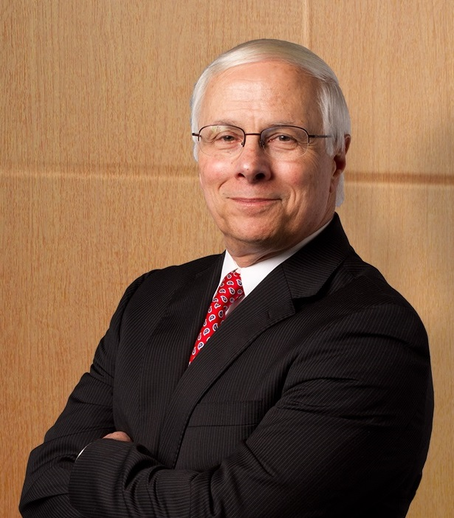
Jim Pyles
Powers Pyles Sutter & Verville
Jim Pyles is a co-founder of and a principal at Powers Pyles Sutter & Verville. He has more than 40 years of experience in health law and policy, and he actively participates in health reform at federal and state levels. Nationally, he is known for his expertise with legal issues related to health information technology and health information privacy.
The Powers Pyles Sutter & Verville Healthcare Group represents healthcare entities of all sizes and practices, working to influence legislative and administrative policy and to represent their clients’ interest before the courts and agencies.
(202) 872-6731
Jim.Pyles@PowersLaw.com
www.powerslaw.com

